Slide 1
Understanding the Chambers Plan
A plan by chamber people, for chamber people.

Slide 2
2017-8 Plan Results
Ontario Net + $ 4.5 Million!!!

Slide 3
Administration Fees to Chambers In Ontario

Slide 4
Provincial Retention Last Year, All Ontario Firms;
93.7%

Slide 5
Best Practices
Meet with your local advisor semi-annually
It’s “YOUR PLAN”, market it
Opportunity for lunch and learns with key business owners
Take the time to understand how the plan works differently and make sure your key staff also understand
Tie in with us and advisors on social media, a lot of key ideas and help for business owners and wellness content can be shared

Slide 6
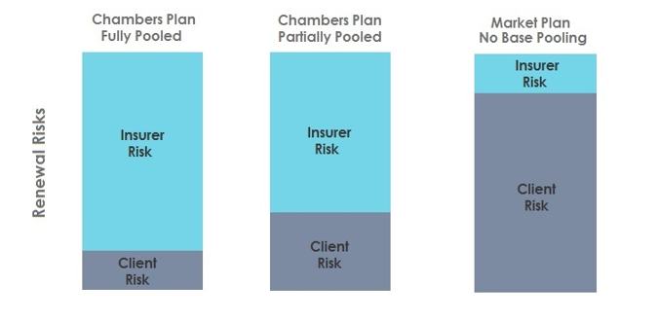
How Is The Plan Different In The Marketplace? In A Word - Risk

Slide 7
How To Describe To A Member Why They Should Look At The Plan?
Supports your local Chamber
Less overhead, not for profit plan and no reserves collected from clients
The largest pooling system in the country with stability for renewals
Competitive rates, with less overhead it’s a logical statement
Constant evolution, even if they looked at the plan 2 years ago so many things have improved with new options, different pricing structures and more flexibility and focus on “Wellness”
Great technology, “my-benefits”, full integration on payroll with Tandem
The Chambers Plan pays its claims in a timely fashion

Slide 8
Thank You
Brett Tanner
Regional Marketing Director
Chambers Plan Ontario
brett@tannerfinancial.ca
1 888 666 8777 ext 108

